Slide 1
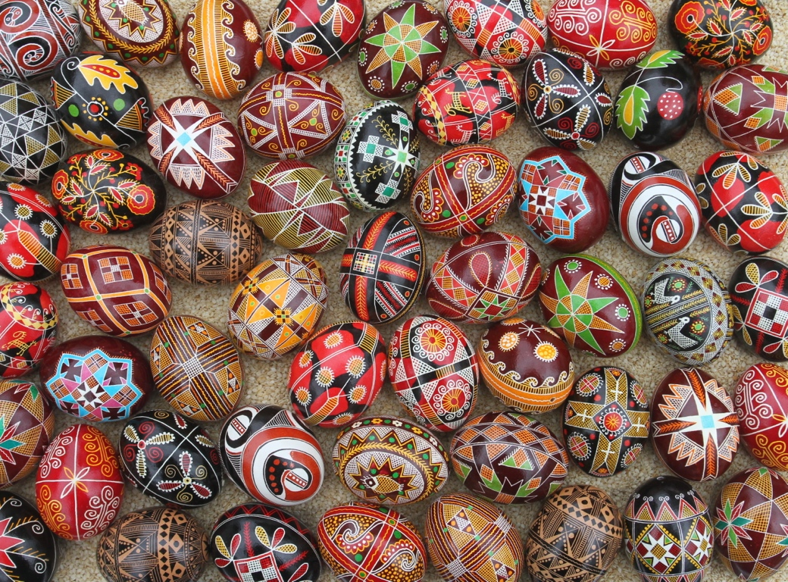

Slide 2
A pysanka (Ukrainian: писанка, plural: pysanky) is a Ukrainian Easter egg, decorated with traditional Ukrainian folk designs using a wax-resist method.
The word pysanka comes from the verb pysaty, "to write", as the designs are not painted on, but written with beeswax.

Slide 3
All Eastern European nations color eggs for Easter. The simplest of these are krashanky, one color eggs, traditionally colored by boiling the eggs with onion skins.

Slide 4
In some Eastern European nations plant material is applied to the egg to create lystovky (aka “Pace eggs”).

Slide 5
There are many types of egg decoration in Eastern Europe. Scratchwork eggs are created by many ethnicities.

Slide 6
Easter eggs are sometimes painted.

Slide 7
Applying beads to eggs is a traditional form of egg decoration in Romania.

Slide 8
Special colored waxes (encaustic) are sometimes applied to eggs.

Slide 9
Paper can be glued to eggs.

Slide 10
As can bullrushes.

Slide 11
Among theCzechs and Slovaks, placing wirework around an egg is a traditional art.

Slide 12
Today we will discuss one form of egg decoration--wax resist (aka batik). Wax is applied to the surface of an egg and put through a series of dye baths.
The wax can be applied with a writing tool, a pinhead, or even a feather.

Slide 13
Eggs decorated using wax resist (batik) are common throughout Eastern Europe, among most Slavic nations and several “Slavic-adjacent” ones.

Slide 14
Belarusians: пісанка (pisanka)

Slide 15
Bulgarians: писано яйце (pisano yaytse)

Slide 16
Croats: pisanica

Slide 17
Czechs: kraslice

Slide 18
Hungarians: hímestojás

Slide 19
Lithuanians: margutis

Slide 20
Poles: pisanka

Slide 21
Romanians: ouă vopsite, incondeiate or impistrite

Slide 22
Serbs: pisanica

Slide 23
Slovaks: kraslica

Slide 24
Slovenes: pisanica, pirhi or remenke

Slide 25
Sorbs: jejka pisać

Slide 26
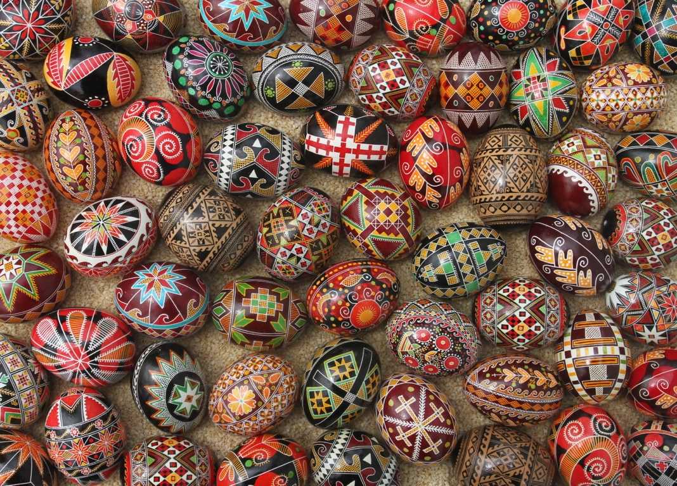
Ukrainian: писанка (pysanka)

Slide 27
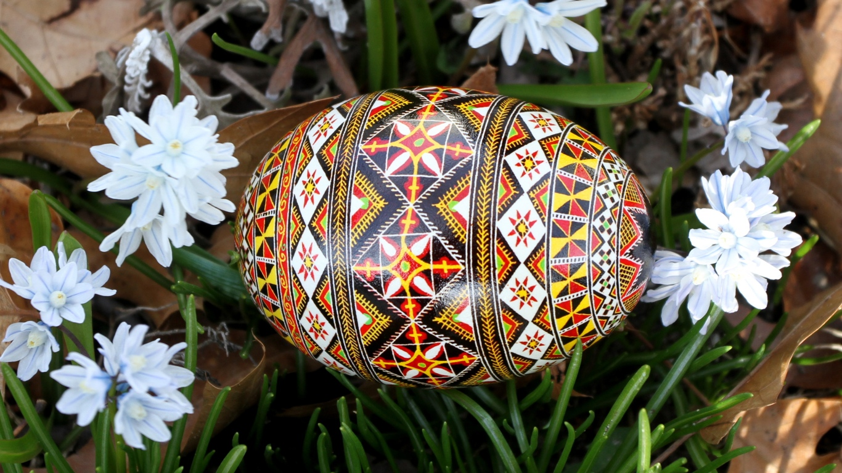
In most Eastern European nations that create wax resist eggs, the practice is a regional one. The exception to this is Ukraine--pysanky were written in every single ethnographic region of Ukraine in the pre-Soviet era.
Scholars are not sure if this was because the practice died out in some areas, or that it never spread to them.

Slide 28
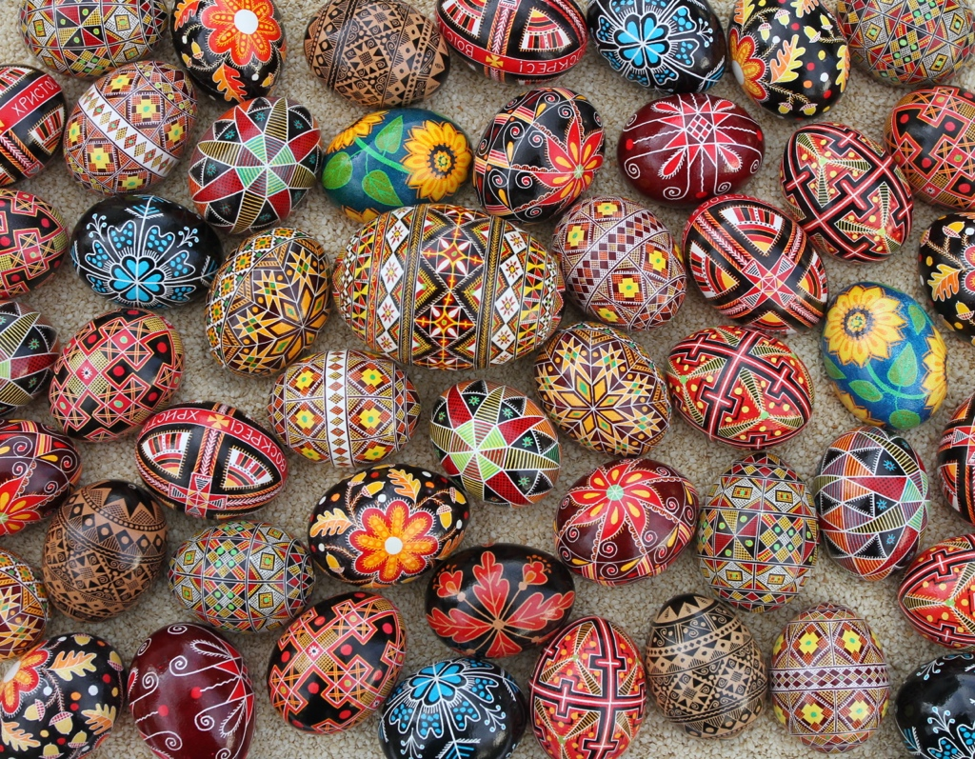
Ukrainian Pysanky

Slide 29
Pysanky
There are two types of pysanky:
1. Folk pysanky, which have designs that have been handed over many generations
2. Avtorski/modern pysanky, which have original designs created by an artist, often incorporating traditional motifs

Slide 30
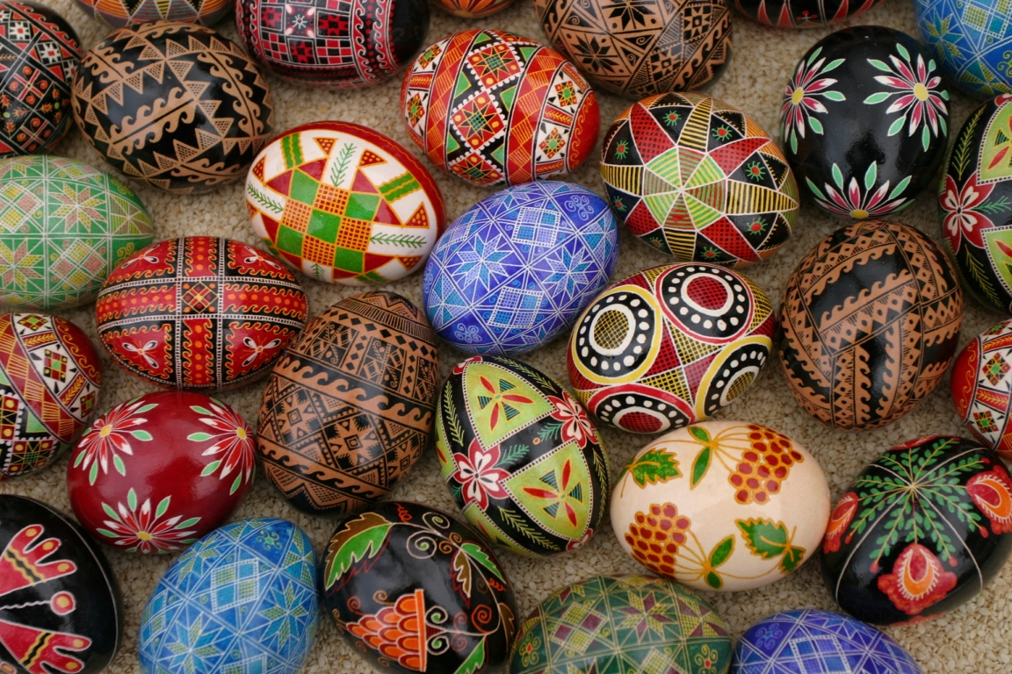
Avtorski/Modern Pysanky
Avtorsky pysanky are the type most often seen in the Diaspora: intricate, colorful designs created by the individual pysankar or pysankarka. Although most Ukrainians have tried their hand at writing pysanky at least once, most of the pysanky you see–in shops, catalogs or china cabinets–were created by professional pysanka artists.

Slide 31
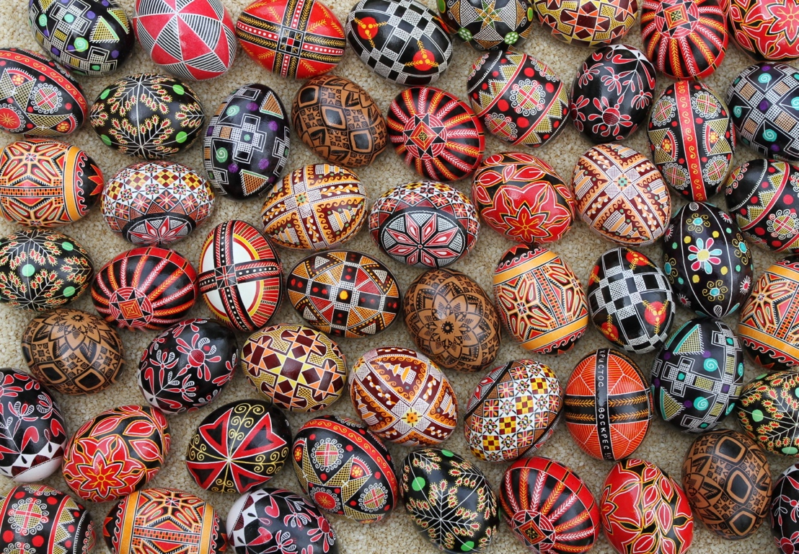

Slide 32
Ukrainian Folk Pysanky
The designs are often simple, and color palette limited--these pysanky were created not primarily to please the eye. They were talismanic objects, whose designs and symbols stretch back into Ukrainian prehistory, into pre-christian times. They were written by the women of each household to protect their families, to chase away evil spirits, to ensure the fertility of their fields and animals, and to ensure the return of the warming sun each and every spring.

Slide 33
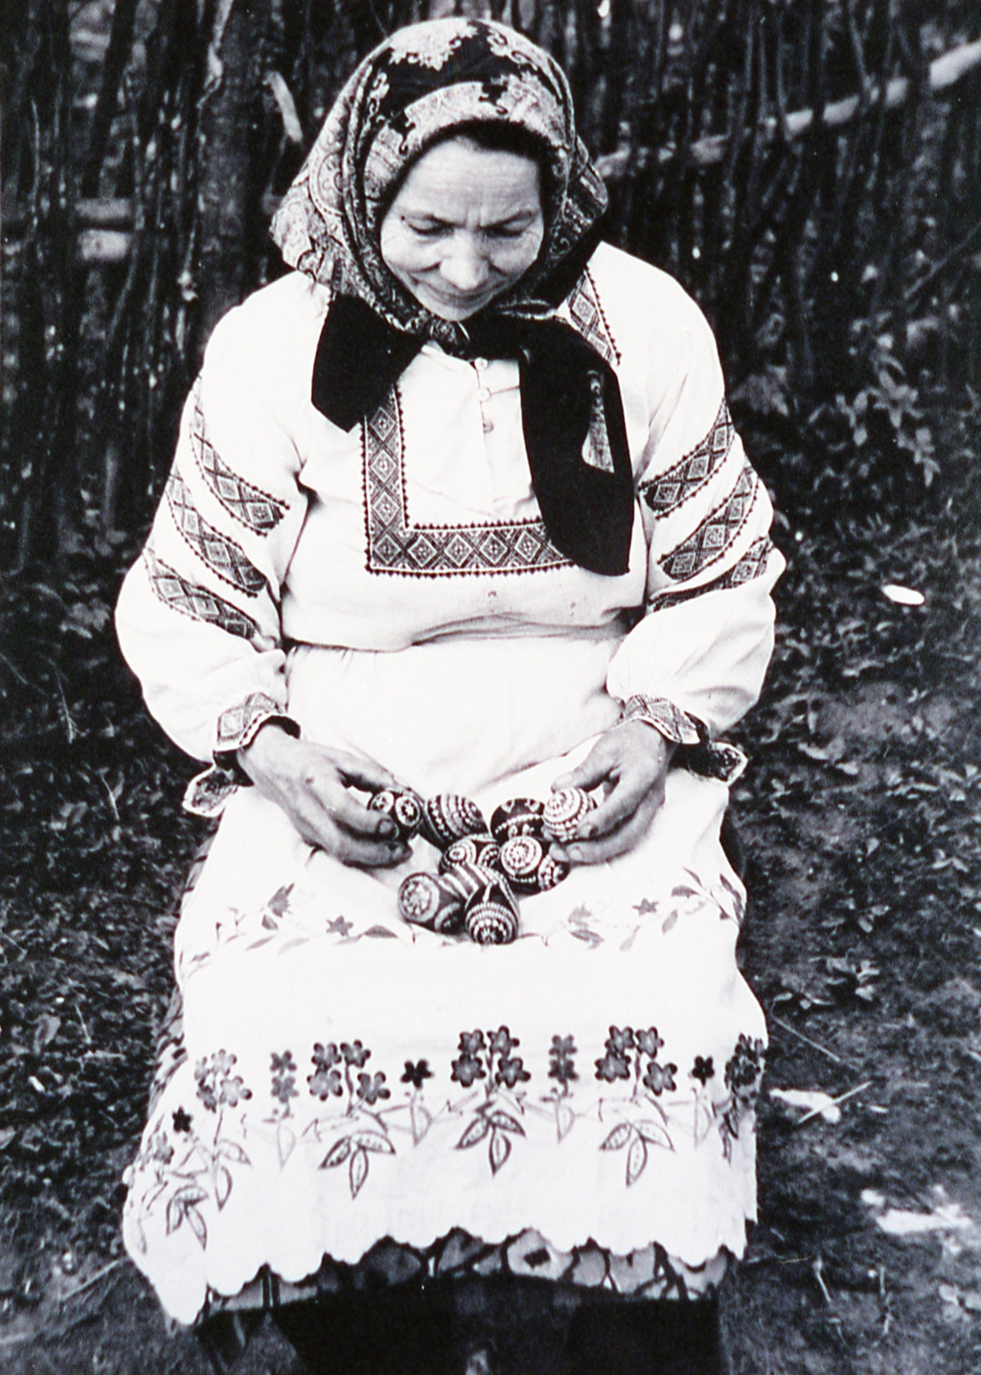
When were pysanky written?
Pysanky were written beginning on Stritennia (Стрітення) and up to Easter itself. Stritennia, which falls on February 2nd (old calendar, and is celebrated on the 15th on the modern calendar) is the day on which it was said winter meets spring.
In many areas pysanky were written predominantly during Holy Week, the last week of Lent, although this varied a bit from region to region.

Slide 34
Who wrote pysanky?
Pysanky were traditionally written by the women of the family; men and children would have been excluded from the process. The writing of pysanky was a traditional women’s activity.

Slide 35
What kinds of eggs were used?
In more modern times, particularly from the mid-19th century on, pysanky have generally been made with chicken eggs, or those of other domesticated fowl (goose and duck). In earlier times, all sorts of eggs were utilized, including those of swans and cranes.

Slide 36
How were dyes prepared?
For talismanic reasons, the water needed to be “live” water, that which comes to earth from the sky (rainwater). It was believed that water from the first spring rain (that which wakes nature from its long winter sleep) was best. Live water was felt to have powerful magic, and this magic could be transferred to the pysanka.
Dyestuffs were collected throughout the year, dried and saved. They consisted of mostly of plant material, including leaves, flowers, roots, bark and berries.
Nowadays, mostly chemical (acid) dyes are used.

Slide 37
How were the styluses prepared?
Styluses were prepared at home, usually by taking a thin piece of brass and wrapping it around a needle, forming a hollow cone. This cone was then attached to a small stick (willow was preferred) with wire, string or horsehair.
In some regions, which often preferred drop-pull pysanky to linear ones, making a stylus was much much more straightforward. A pin or small nail would be simply be driven into the end of a small stick.

Slide 38
How was the wax applied?
Coals were heaped into a small mound, and a bowl of wax placed upon them. The heat from the coals would melt the wax, and keep it melted. Each pysankarka usually had at least two styluses, which would be kept dipped into the bowl when not in use. This would keep the stylus warm and full of wax. (Note the bowl of wax on the stove in the picture on the left.)
The pysankarka would remove one stylus from the bowl, and write with it until the wax cooled; she would replace it into the bowl, and take another, and continue writing. This process would be repeated until she finished her design.

Slide 39
How were the eggs dyed?
Pysanky were usually made in batches, rather than one at a time as many people do nowadays. Because dyeing times with natural dyes were so much longer than with modern aniline dyes (measured in hours rather than minutes), it was simpler to write and dye them in batches.
Because of the long dyeing times of botanical dyes, color schemes of traditional pysanky were usually fairly simple. Two color eggs (white and a final color) were common, particularly among the Lemky, as were three and four color eggs.

Slide 40
How was the wax removed?
Once the eggs had been fully written, and the final dyebath was complete, the wax was removed. The pysanky would be placed in an earthenware bowl, and that bowl placed into a warm oven (35-40°C). The wax would slowly melt and flow off of the pysanka. A soft cloth would be used to wipe them clean.

Slide 41
Were pysanky emptied or left full?
Traditional pysanky created for talismanic reasons – as opposed to decorative ones – were made using full, fertilized eggs, and these eggs were never emptied. It was the entire egg, including yolk and white, which was felt to have magical properties. Removing the white and yolk, or even using unfertilized eggs, would have been unthinkable.

Slide 42
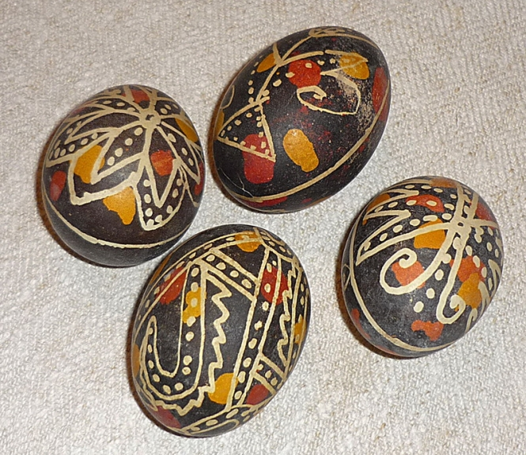
Were pysanky varnished?
No. Varnishing pysanky is a relatively recent innovation (20th century). In earlier times, a pysankarka might rub some pork or duck fat on a pysanka to make it gleam, but would not have thought to varnish it.

Slide 43
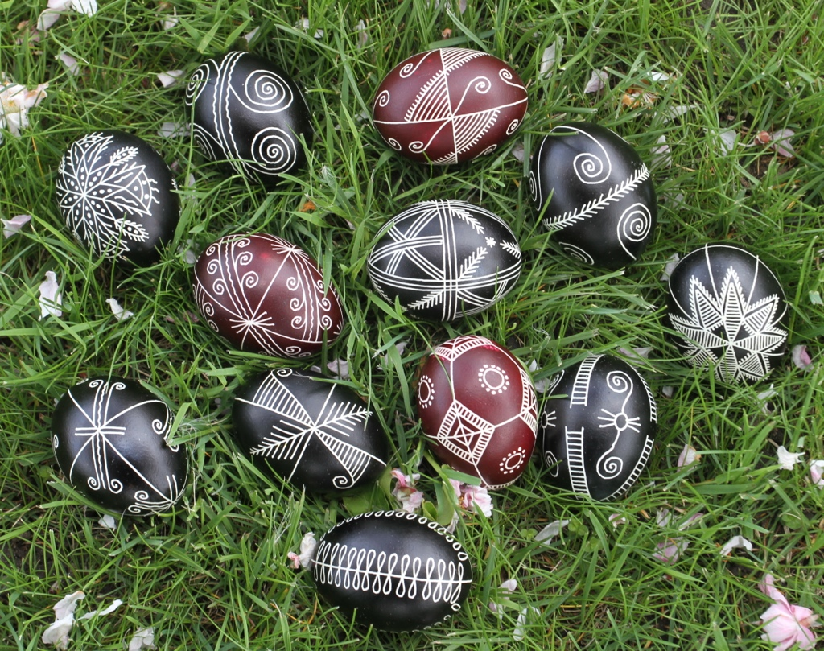
What were pysanky used for?
Protection of the home from fire, evil spirits
Ensure fertility of the fields
Ensure fertility of the farm animals
Ensure health of the bees
Ensure a good crop from the fruit trees
Placed on family graves on Provody
Placed in the coffin if a family member died
Given to friends and family

Slide 44
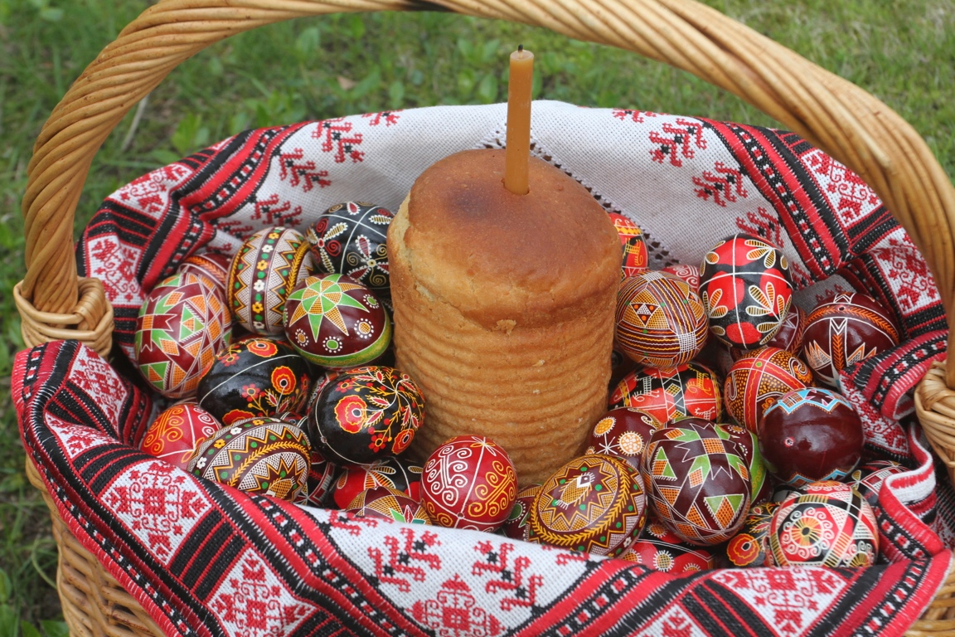

Slide 45
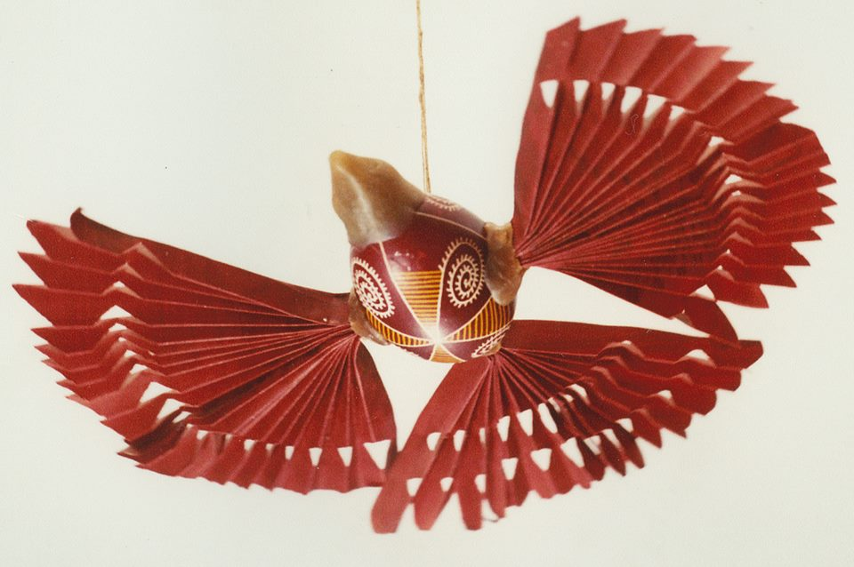
How were pysanky displayed?
Pysanky which weren’t used in a ritual manner (hung in stables or bee hives, placed in coffins or near graves, put into newly plowed fields) were usually displayed in the home, often near the icons. Each house would usually have at least one pair of icons in a corner (these would be the wedding icons), and the pysanky would usually be kept in a bowl near them.
In some parts of Ukraine, pysanky would be turned into birds and hung, suspended from the ceiling, near the icons. A bird’s head would be made of wax or bread dough, and wings and tail feathers of folded paper attached.

Slide 46
Why were pysanky written?
Pysanky were written for different reasons at different times. In pre-modern times, they were written for talismanic reasons:
to insure the return of the sun and of spring
to insure fertility of the fields and livestock
for protection from various dangers – from fire and other catastrophes, and from the various devils and demons that might be about
The most common symbols on traditional pysanky are sun symbols, but we also find representations of the old gods.

Slide 47
Why were pysanky written?
In more modern times, pysanky are written for commercial reasons (to sell) or, more commonly, simply for their pure beauty. In the words of Keats
A thing of beauty is a joy for ever:
Its loveliness increases; it will never
Pass into nothingness
And, as Emerson more succinctly noted, “Beauty is its own excuse for being.”

Slide 48
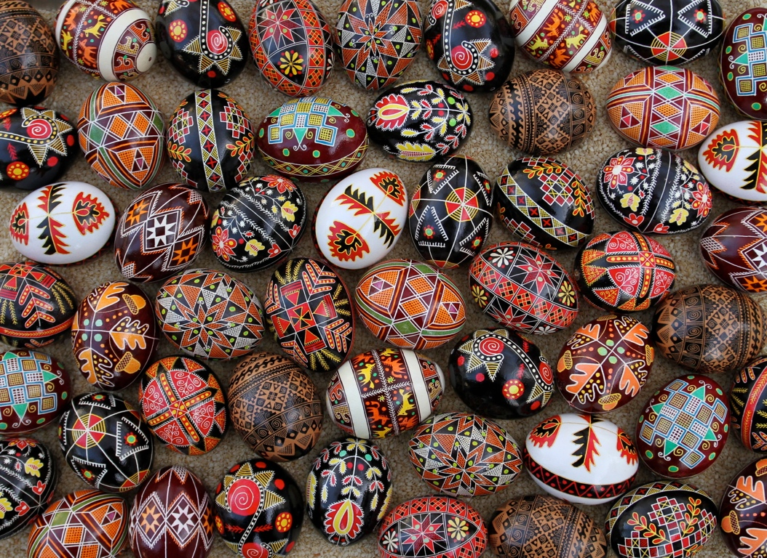

Slide 49
Symbols and Motifs

Slide 50
Animal Symbols
Zoomorphic

Slide 51
Stags & Horses
Solar (sun) symbols

Slide 52
Rams and Ram horns
Strength, perseverance

Slide 53
Wild Birds
Sun symbols

Slide 54
Poultry
Fertility

Slide 55
Fish
Life, health, fertility;Christ

Slide 56
Spider and spider web
Good luck

Slide 57
Geometric Symbols

Slide 58
Sorokoklyn
(Forty Triangles)
40 days of Lent

Slide 59
Rhombs and Triangles
Farm fields

Slide 60
Tripod
Various trinities

Slide 61
Spirals and curls
Protection; Zmiya

Slide 62
Hearts
Love

Slide 63
Plant Symbols
Phytomorphic

Slide 64
Pine, horsetail
Eternal youth

Slide 65
Trees, branches, leaves
Strength, growth

Slide 66
Oak: leaves and acorns
Perun; health, long life

Slide 67
Tree of Life (Vazon)
Plant fertility

Slide 68
Grapes
Good harvest; Holy communion

Slide 69
Flowers
Love, wisdom

Slide 70
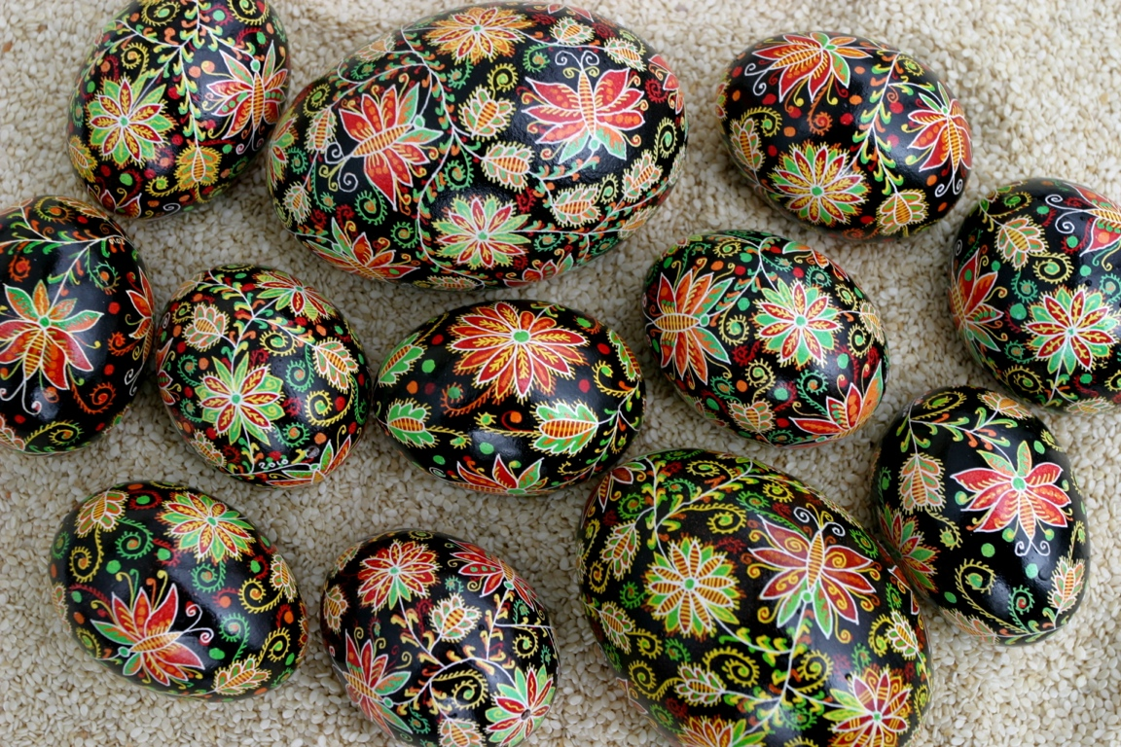

Slide 71
Household Symbols
Scevomorphic

Slide 72
Sieve (Resheto)
Plowed fields

Slide 73
Rakes, combs
Cloud symbols: rain, water

Slide 74
Windmills (Svarha)
Svaroh: movement of the sun across the sky

Slide 75
Religious Symbols

Slide 76
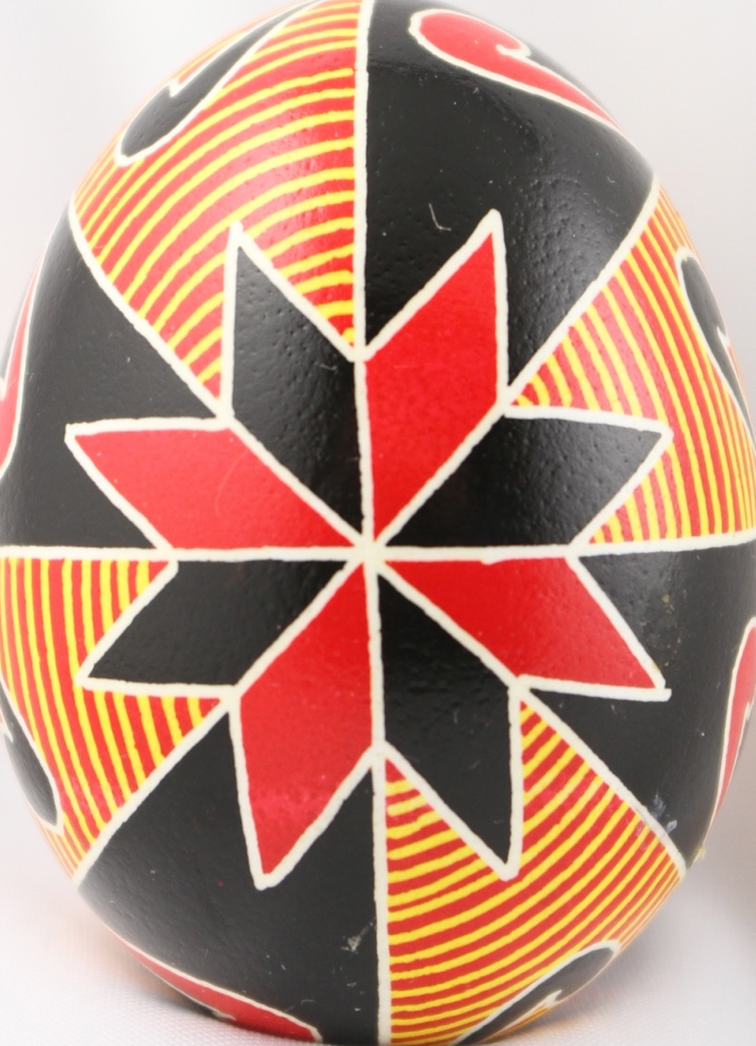
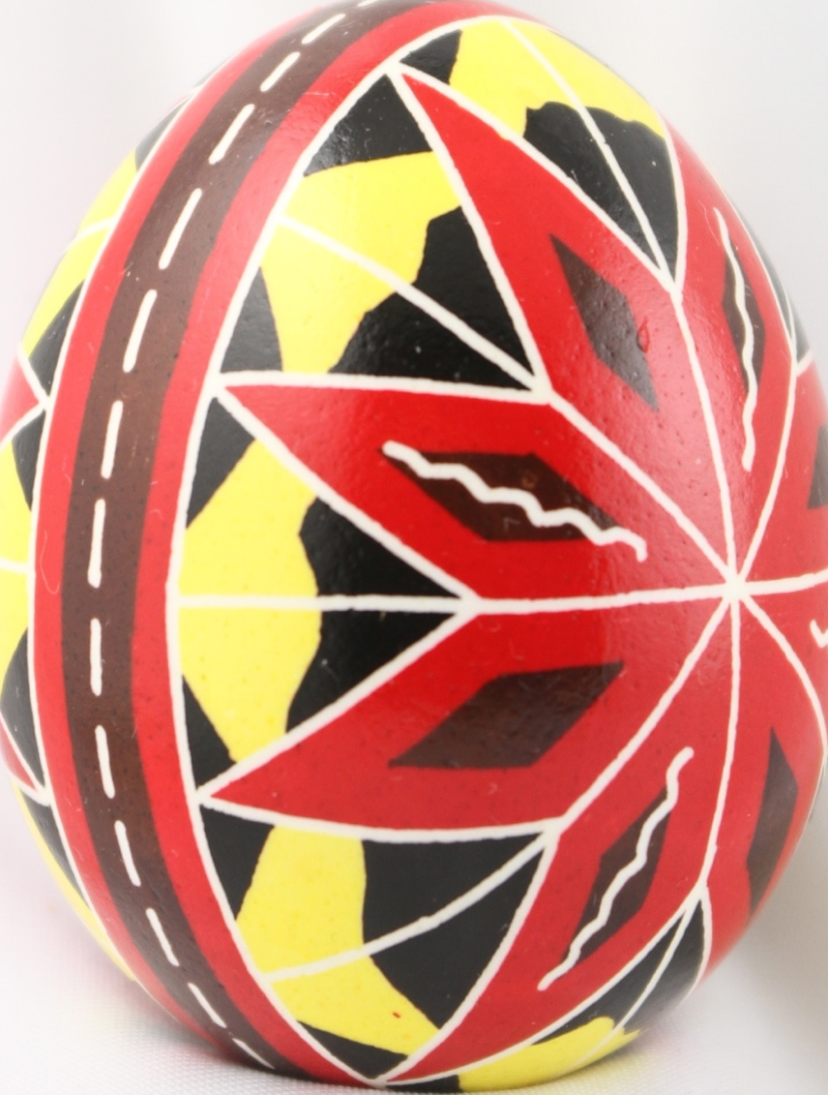
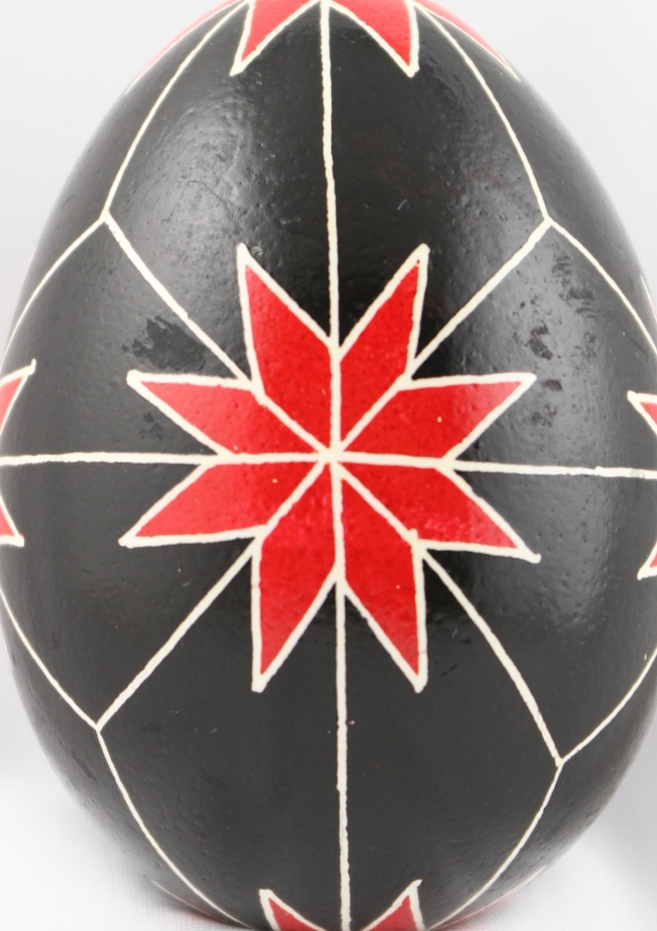
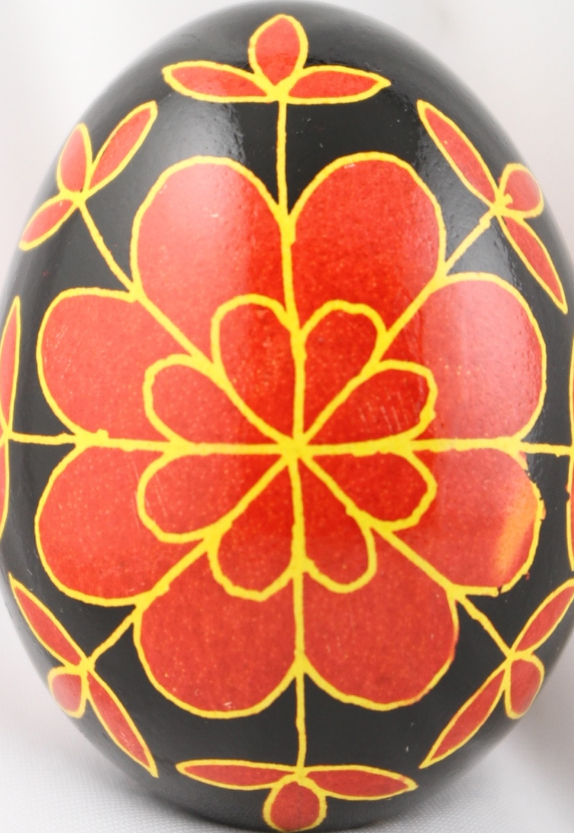
Ruzha (Mallow)
Sun symbol

Slide 77
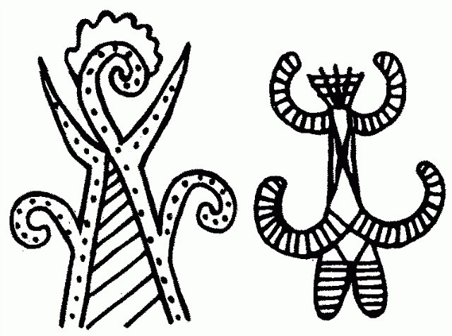
Berehynia
The great goddess

Slide 78
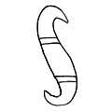
Serpent (Zmiya)
Water god

Slide 79
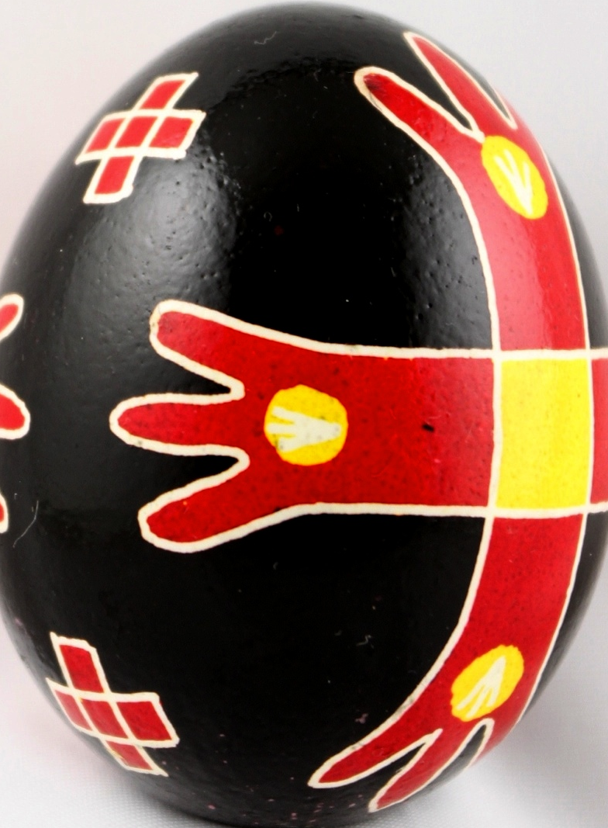
Cross
Sun Symbol

Slide 80
Churches

Slide 81
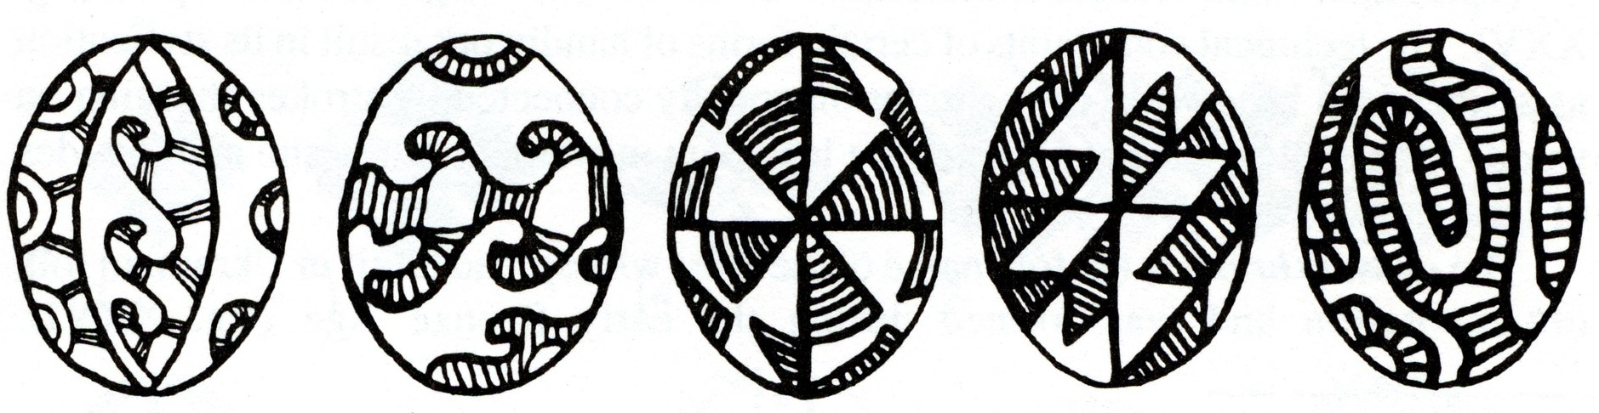
Meander (Bezkonechnyk)
Eternity

Slide 82
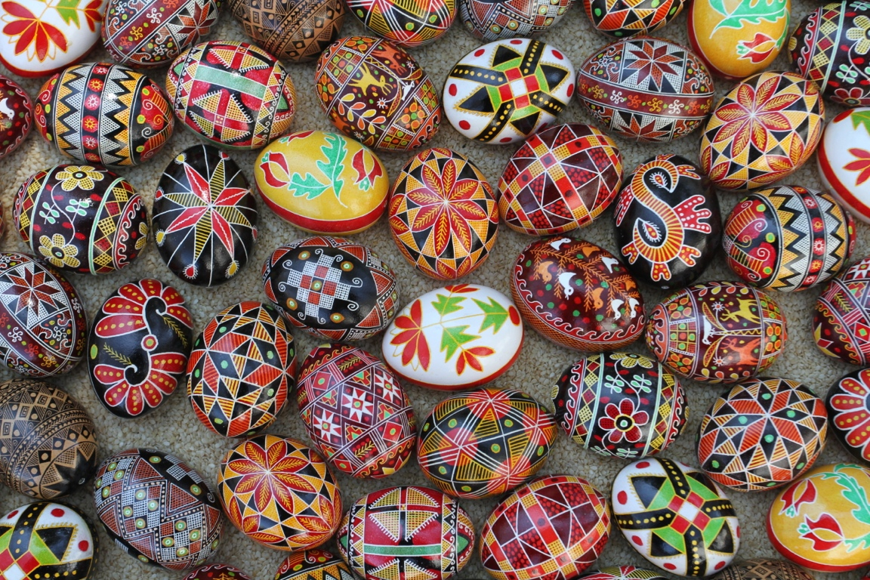

Slide 83
Movie

Slide 84
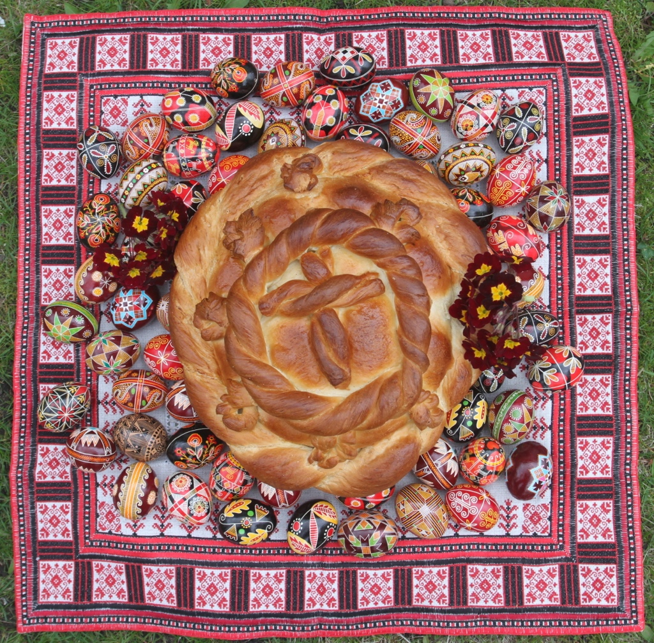

Slide 85
INSTRUCTIONS
Tie back hair!!! DO NOT erase! Use wipes to remove pencil mistakes.
Write with the egg on the table, not up in the air. When you are not working on your pysanka, leave it safely near the center of the table so it does not roll off.

Slide 86
Dyes
Place the egg gently into the dye with a spoon.
When removing the egg from the dye, grab it with the paper towel; don’t pour the egg and dye into your hand.

Slide 87
Have Fun!!!!!

Slide 88
For more information, go to
pysanky.info

